Slide 1

The Augmented Analyst: A Simulated Study Evaluating the Impact of Explainable AI on Security Operations Centre Workflow.
Presenter: Cristhian M. Faria-Sanchez.
Student ID: 12693874
Class: Research Methods and Professional Practice April 2025 B
Professor: Dr Diego Navarra

Slide 2
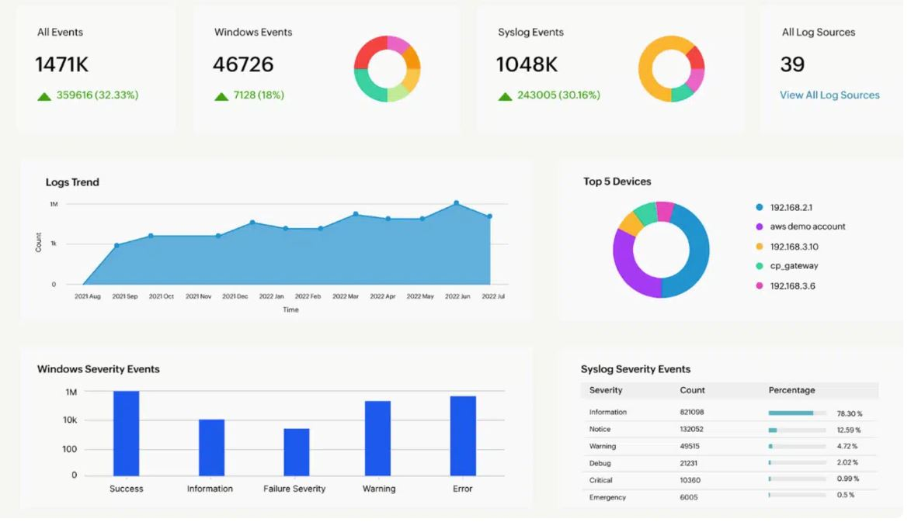
The SOC in Crisis: Problem & Significance
The Chronic Crisis
The "AI Paradox"
The Critical Risk
The Research Gap

Slide 3
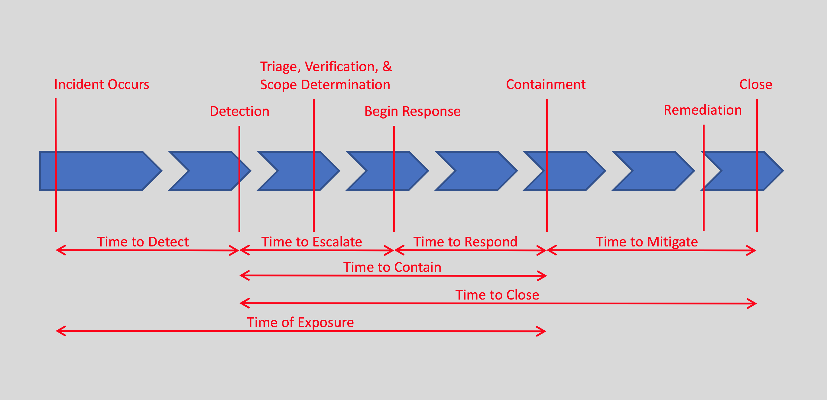
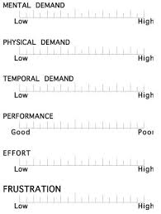
Research Question & Objectives
Central Question: Can the integration of Explainable AI (XAI) into an analyst's workflow improve the performance, efficiency and confidence of a SOC analyst during a live-fire attack simulation?
Objectives:
Quantify Performance: Measure Mean Time to Detect (MTTD) and Mean Time to Respond (MTTR), with and the XAI output
Evaluate Decisions: Assess the accuracy and soundness of analyst decisions using a non-technical skills framework. Currently I plan to adapt on the UK Rail Safety and Standards framework.
Analyze Human Factor: Measure cognitive load with the NASA Task Load Index (NASA-TLX) and qualitatively assess trust and situational awareness.

Slide 4
Methodology Part 1 - The Experimental Environment
This will involve a virtual environment with a simulated attack.
Two snapshots will be taken, one without XAI enrichment and a slightly different simulation without.
Components:
A Windows Desktop virtual machine, which will serve as the target endpoint for the simulated attack.
A GNU/Linux Server VM(likely Ubuntu), which will host both the SIEM for security monitoring and the MITRE Caldera server for adversary emulation.
An internet gateway VM that will act as a firewall, logging proxy and potentially; as a parser for logs towards the LLM API if this cannot be performed at the log forwarder on the linux system.

Slide 5
Methodology Part 2 - The Experiment
Phase 1: The Baseline:
Phase 2: The XAI Enhancement:
Action: A pre-defined, scripted attack is executed using MITRE Caldera.
Analyst Task: The participant investigates the incident using SIEM interface with ML based alerts.
Purpose: To establish baseline metrics for performance and cognitive load.
Action: Another very similar lab, using the same attack techniques but different order and IOC's is started.
The Experimental Variable: The inclusion of an LLM tuned with XAI in mind, potentially following frameworks like "SHAP".
Analyst Task: The participant investigates the same incident, but now with the aid of the XAI-enhanced alerts.

Slide 6

Methodology Part 3 - Evaluation Frameworks & Challenges
Quantitative Performance:
I'll measure the Mean Time to Detect and Respond. Likely in the form of set goals, e.g. identifying the C2 channel; which will be done while I record.
For Cognitive Load:
I will administer the NASA-TLX, a standardized survey that quantifies the mental workload experienced by the analysts in each phase. I am currently considering allowing for short breaks between sections which will be where I will perform the survey.
For Qualitative Analysis:
I will conduct structured interviews guided by a the modified non-technical skills framework, focusing on the analysts' situational awareness and decision-making processes

Slide 7
Evaluation Framework, Challenges and Artefacts
Evaluation:
Quantitative: MTTD/MTTR.
Qualitative: Structured interviews guided by a non-technical skills framework.
Cognitive: Standardized NASA-TLX survey.
Anticipated Challenges & Mitigations: .
Technical Complexity.
Participant Recruiting
LLM Unpredictability.
Cost/Time Restraints
Artefacts
Lab configurations
SIEM Configurations
XAI Script
Data Analysis Results and Findings

Slide 8
Ethical Considerations
Informed Consent: All participants will be fully briefed on the study's purpose, procedures, and their rights. They will be required to sign a consent form before participation.
Anonymity and Confidentiality: All collected data, from performance metrics to interview recordings, will be fully anonymized to protect the identity of the participants and their employers.
Data Security: All research data will be stored on an encrypted drive, accessible only by myself, to ensure its security and integrity.

Slide 9
Timeline
Weeks 1 to 4 will be dedicated to the setup of the lab and tools.
Weeks 4 to 7 will focus on the creation of the XAI script and creating the attack scenarios in Caldera.
Week 8 will involve a pilot study where I run through the scenarios on my own to identify potential issues
Weeks 9 to 11 are the main Data Collection window, where I will work with the three+ participants.
Weeks 12 to 14 will be for Data Analysis, where I will process the quantitative and qualitative data.
Weeks 15 and 16 will be for the Final Report write-up and project submission.

Slide 10

Conclusion
Thank you

